Slide 1
TI Keystone Networking Coprocessor Introduction
KeyStone Training

Slide 2
Why Network Co Processor (NetCP):
Motivation behind NETCP:
Use firmware based PDSP (Packet Descriptor Processors) to do processing and encryption.
Goals for both Packet Accelerator and Security Accelerator:
Offload processing from the cores
Improve system integration
Allow cost savings at the system level
Security Key applications:
IPSec tunnel endpoint (e.g. LTE eNB, ...)
Secure RTP (SRTP)
Air interface (2G/3G/4G) security processing
Notes:
2

Slide 3
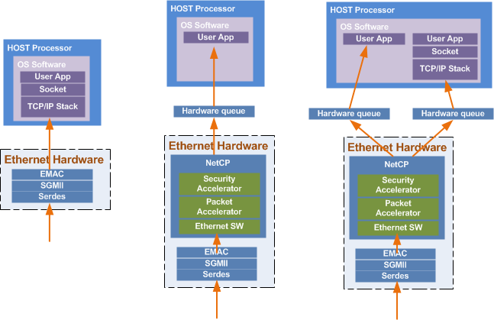
Why Network Co Processor (NetCP)
Generic Network Processing
Keystone Network Processing with NetCP full offload
Keystone Network Processing with NetCP Partial offload
Notes:
3

Slide 4
Agenda
KeyStone I/NetCP1.0
  Overview
  Typical Application
  PA 1.0
KeyStone II/ NetCP1.5
  Overview
  Typical Application
  PA 1.5
  NetCP QMSS/PDSP Firmware/RA
NetCP 1.0 Vs NetCP1.5
Security Accelerator
  Overview
  Channel Configuration
  Data Process
Notes:
NEW

Slide 5
KeyStone I Network Coprocessor
Application-Specific
Provides hardware accelerators to perform L2, L3, and L4 processing and encryption that was previously done in software
Packet Accelerator (PA)
  Single or multiple IP address option
  UDP (and TCP) checksum and selected CRCs
  L2/L3/L4 support
  Quality of Service (QoS)
  Multicast to multiple destinations inside the device
  Timestamps
Security Accelerator (SA)
  Hardware encryption, decryption, and authentication
  Supports IPsec ESP, IPsec AH, SRTP, and 3GPP protocols
Memory Subsystem
Coprocessors
DDR3 EMIF
MSM
SRAM
MSMC
C66x™
CorePac
L1P
L1D
Cache/RAM
Cache/RAM
L2 Memory Cache/RAM
Miscellaneous
1 to 8 Cores @ up to 1.25 GHz
HyperLink
TeraNet
Multicore Navigator
Queue
Packet
Manager
DMA
t
e
h
n
c
Security
r
t
h
External Interfaces
e
i
c
h
w
t
Accelerator
t
S
i
E
w
S
Packet
I
Accelerator
I
M
x2
G
S
Network Coprocessor
Notes:
5
NEW

Slide 6
Packet Accelerator 1.0 Block Diagram
Provides hardware accelerators to perform the packet classification for Ethernet L2, L3, and L4
  Hardware Lookup table (LUT1 64 entry/table, LUT2 8K entry/table)
Based on use case firmware can be redefined/developed
Engines for modification (IP header/UDP header checksum, IP fragmentation, update PPPoE header)
Multi routing (same packet can be copied and routed to 8 different queue)
Notes:
Generally PDSP0~PDSP3 for packet classification on Ingress direction (from network)
PDSP4~PDSP5 for packet modification on Egress direction (to network)

Slide 7
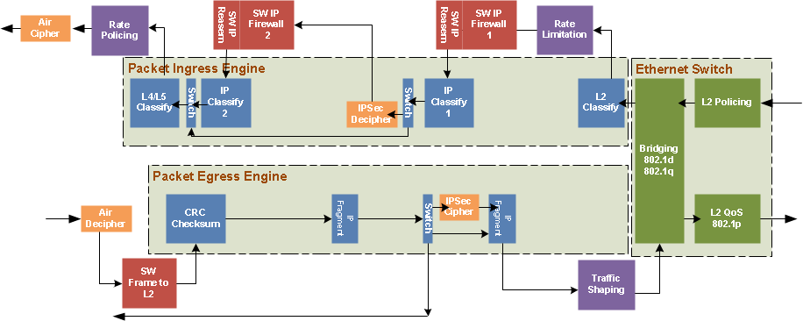
NetCP1.0 Typical Application
Software for IP reasembly
Software IP Firewall
Software for Packet Framing on to-network direction

Slide 8
Agenda
KeyStone I/NetCP1.0
  Overview
  Typical Application
  PA 1.0
KeyStone II/ NetCP1.5
  Overview
  Typical Application
  PA 1.5
  NetCP QMSS/PDSP Firmware/RA
NetCP 1.0 Vs NetCP1.5
Security Accelerator
  Overview
  Channel Configuration
  Data Process
Notes:
NEW

Slide 9
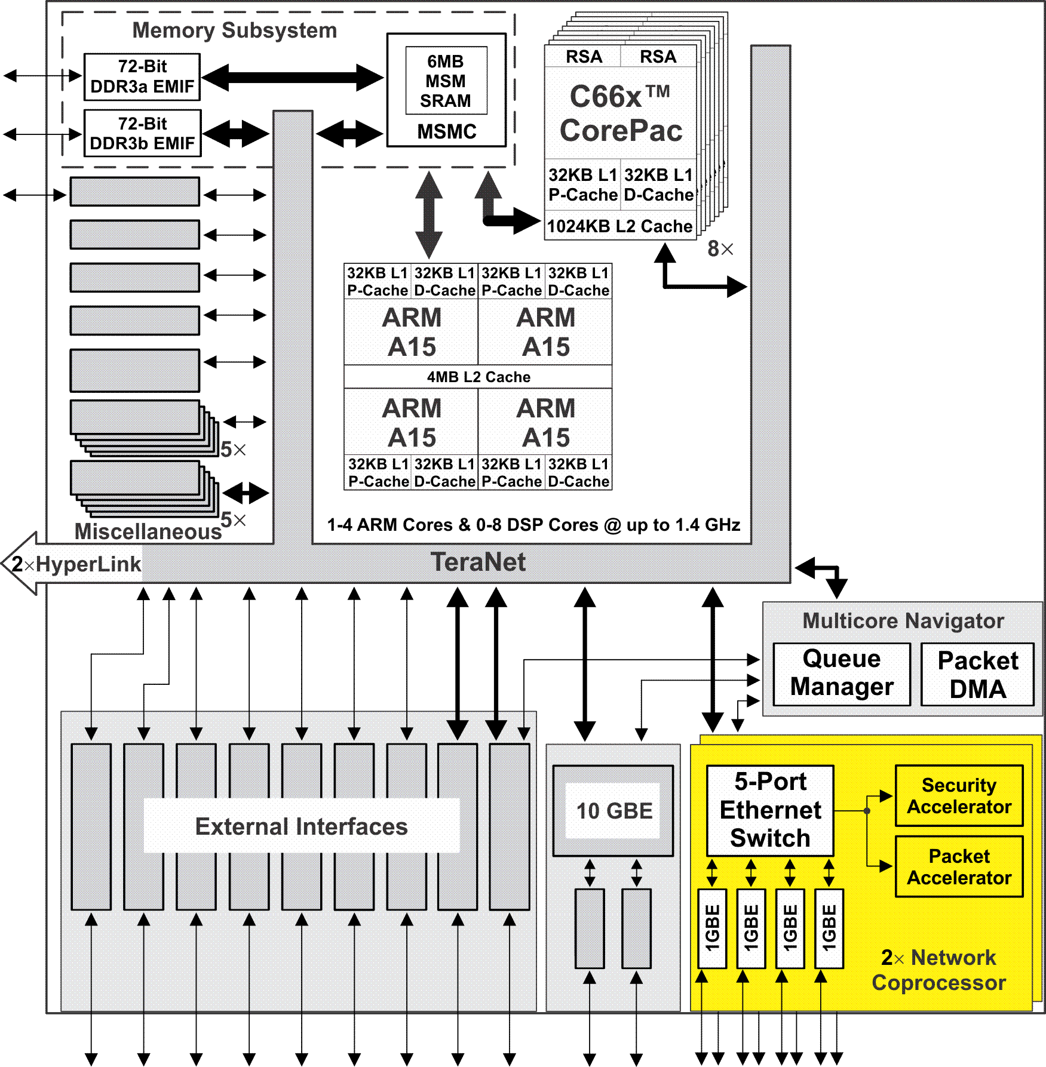
KeyStone II Network Coprocessor (NETCP)
Consists of one or two Network Coprocessor(s)
Provides hardware accelerators to perform L2, L3, and L4 processing and encryption that was previously done in software
Packet Accelerator (PA)
  Single IP address option
  UDP (and TCP) checksum and selected CRCs
  L2/L3/L4 support
  Quality of Service (QoS)
  Multicast to multiple queues
  Timestamps
Security Accelerator (SA)
  Hardware encryption, decryption, and authentication
  Supports IPsec ESP, IPsec AH, SRTP, and 3GPP protocols
  2x 5-port Ethernet switches (depending on number of instances of NETCP) with 4-8 ports connecting to 4-8 SGMII ports and one port connecting to the Packet and Security Accelerators.
Notes:
9
Same as KS I except we have a 5 port switch inside the NetCP instead of a 3 port switch.
Some device variation we might have 2 instance of the netCp to increase the supported BW.
PA and SA are same.

Slide 10
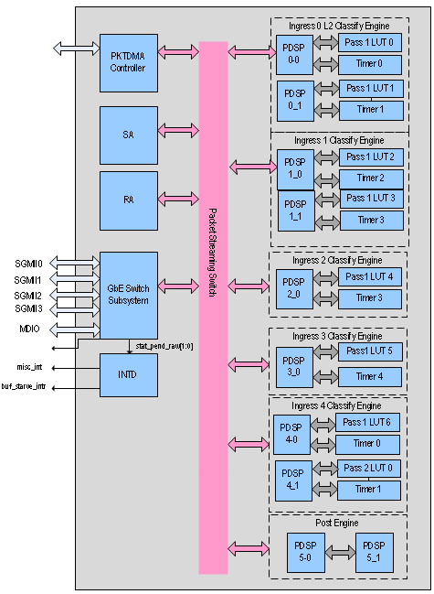
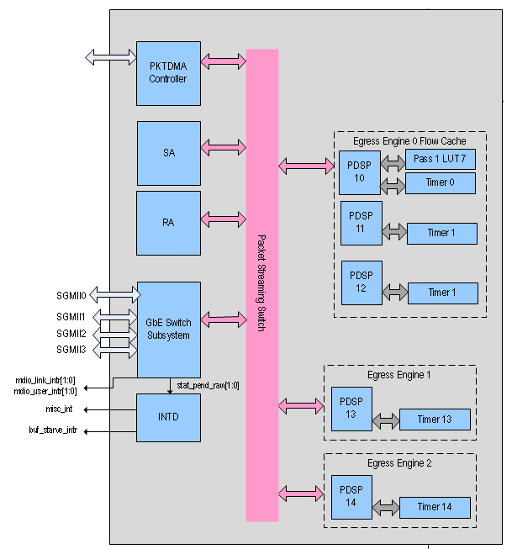
Packet Accelerator 1.5 Block Diagram
Notes:
Ingress 0:
PDSP0_0 L2(MAC) Classification
PDSP0_1 Outer IP (Pre-RA) Firewall/ Reassembly Engine Preperation
Ingress 1:
PDSP1_0 L3/L4 Classification (Outer IP)/NAT-T Detection
PDSP1_1 IPSEC Classification stage 1
Ingress 2:
PDSP2_0 IPSEC Classification stage 2
Ingress 3:
PDSP3_0 Inner IP (Pre-RA) Firewall/Reassembly Engine Preperation
Ingress 4:
PDSP4_0 L3/L4 Classification (Inner IP)/L3/L4 Firewall (Inner IP)/Custom LUT1 classification
PDSP4_1 L4 Classification/CustomLUT2 classification
Post Processing:
PDSP5_0 Post-Classification Processing Post Processing
PDSP5_1 Post-Classification Processing
Egress 0:
PDSP10 Flow Cache/CRC/L4 checksum
PDSP11 Flow Cache record level0
PDSP12 Flow cache record level0/1 /IP Fragmentation/IPSEC prepration
Egress 1:
PDSP13 Flow cache record level1/IPSEC AH preparation
Egress 2:
PDSP14 Post-SA processing/Flow cache record level 2/IP Fragmentation/L2 Framing

Slide 11
Packet Accelerator 1.5
PA LLD interface and features are compatible with NetCP1.0
Provides hardware accelerators to perform the packet classification for Ethernet L2, L3, and L4
  Hardware Lookup table (LUT1 256 entry/table, LUT2 3K entry/table) with mask/range configuration
Each PDSP can do more complex processing (MAX to 3K instructions)
Egress direction has capability to modify a packet as configuration and route it to Ethernet directly

Slide 12
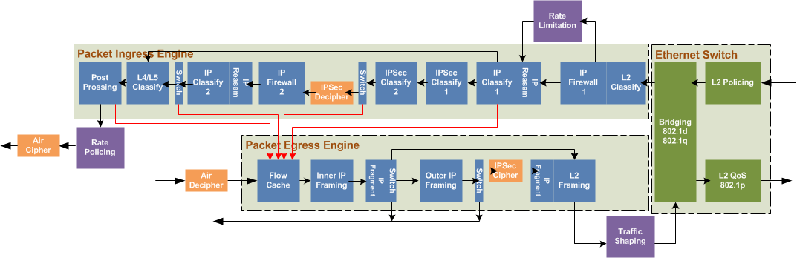
NetCP1.5 Typical Application
Hardware accelerators to do L2, L3, and L4 processing, packet classify
Hardware accelerators for IPSec/air cihper encryption
Hardware QoS for PQ/WRR
Hardware accelerators for IP reasembly
Hardware accelerators for Flow Cache
Hardware accelerators for IP Firewall

Slide 13
NetCP QMSS
The primary use case is for handling CDMA based packet flows between PA and the Security Accelerator (SA) and Reassembly (RA) engines.
Using the PA1.5 queue management subsystem offloads DMA and queue operations from the global PA CDMA and chip-level QMSS.
Provides support for 128 total queues (2 Queue Managers supporting 64 queues each)
  • Supports up to 16K descriptors
  • Supports 16 memory regions for storage of descriptors with each region storing up to 16K descriptors
Provides support for monitoring 21 queues (queues 0 through 20 of Queue Manager 0) by exporting hardware signals indicating queue status to a local CPPI DMA engine.
Provides a 128KB memory region for fast local storage of packet descriptors and/or buffers

Slide 14
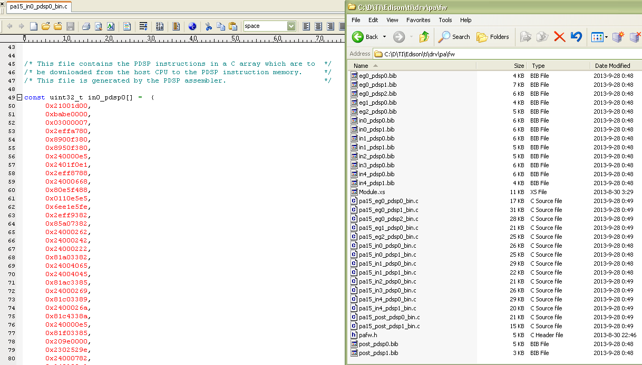
PDSP firmware
Each PDSP has dedicated firmware file with array and binary format

Slide 15
Reassembly Engine
The Reassembly engine is a hardware accelerator block for reassembling fragmented IPv4 and IPv6 Packets
Supports reassembly at 10Gbps rate for up to 1K concurrent contexts
There will be 2 in the system
  Pre-SA decrypt
  Post-SA decrypt
The timeouts will be from 100 to 2³² * 2¹⁰ clock cycles@400MHz

Slide 16
Agenda
KeyStone I/NetCP1.0
  Overview
  Typical Application
  PA 1.0
KeyStone II/ NetCP1.5
  Overview
  Typical Application
  PA 1.5
  NetCP QMSS/PDSP Firmware/RA
NetCP 1.0 Vs NetCP1.5
Security Accelerator
  Overview
  Channel Configuration
  Data Process
Notes:
NEW

Slide 17
NetCP 1.0 Vs 1.5
Applications | 1.0 | 1.5
Maximum IP packet size | 9KB | 64KB
PDSP | PA 6 PDSPs 8KB IRAM/PDSP | PA 15 PDSPs 12KB IRAM/PDSP
LUT | 3 LUT1 with 64 entries 1 LUT2 with 8K entries(32 bit each) | 8 LUT1 (256 entries), mask/range supported 1 LUT2 with 3K entries (64 bit each), range supported
Hardware Firewall | No | 256 entries/ACL for outer IP & 256 entries/ACL for Inner IP
Hardware IP Reassembly | No | Outer IP and inner IP reassembly by hardware
Flow cache | No | Yes
IPSec | Replay widows 128 | Replay widows 1024 Performance 2x 1.0
Air Cipher | Separate Air Ciphering and Authentication No ZUC F8/F9 and Snow3G F9 | Simultaneous Air Ciphering and Authentication Support ZUC F8/F9 and Snow3G F9
Internal memory ECC | No | Yes
Internal QMSS | No | Yes
PKT DMA | 9 Tx channels 24 Rx channels | 21 Tx channels 91 Rx channels
QoS | PQ+WRR | PQ+WRR Performance 4x 1.0
Notes:
ACL Access control List

Slide 18
Agenda
KeyStone I/NetCP1.0
  Overview
  Typical Application
  PA 1.0
KeyStone II/ NetCP1.5
  Overview
  Typical Application
  PA 1.5
  NetCP QMSS/PDSP Firmware/RA
NetCP 1.0 Vs NetCP1.5
Security Accelerator
  Overview
  Channel Configuration
  Data Process
Notes:
NEW

Slide 19
Security Accelerator Overview
Motivation
Hardware Encryption, Decryption, and Authentication
Faster than software
Supported Protocols
IPsec ESP
IPsec AH
SRTP
3GPP
Each security accelerator supports:
Loosely coupled accelerator at 1.5M packets per second
Authentication and replay protection at Gigabit Ethernet wire rate
Pre- and post- algorithm packet header processing and security association maintenance
Context caching for security associations (SW or HW managed)
Can be used by NetCP without host intervention and by SW in parallel
Module Name | Block size (Bits) | Throughput (Mbits/sec) | Remark
AES modes | 128 | 3x 2,800.0 | AES 256-bit key numbers, worst case for modes other than CCM
3DES modes | 64 | 2x 1,493.3 | 3DES 3 key numbers, worst case
Galois Multiplier | 128 | 2x 8,960.0 | Galois multiplier core used for GCM mode
AES modes 128 bit key | 128 | 3x 3,200.0 | AES 128-bit key numbers, worst case for modes other than CCM
AES -CCM - 256 bits AES Key | 128 | 3x 1,400.0 | In CCM mode, AES is run twice for same block.
Kasumi | 64 | 1244.4 | Kasumi in F8 mode
Snow3G | 320 | 1154.6 | SNOW 3G in F8 mode. 40 bytes in one block, for 1500 byte blocks the throughput is above 5Gbit/s
HMAC- SHA1 | 512 | 2x 2,185.4 | SHA 1 core
HMAC- MD5 | 512 | 2x 2,715.2 | MD5 core
HMAC-SHA2 | 512 | 2x 2,715.2 | SHA 2 core(max 256 bit hash)
Notes:
AES : Advanced Encryption Standard
3DES: Triple Data Encryption Algorithm
IPsec :
For generic IP traffic encryption/decryption , Application like VPN
cipher Algorithm: AES/3DES/Galois/AES
SRTP:
For media encryption/decryption , Application like media gateway product
cipher Algorithm: AES/3DES
3GPP:
For air interface encryption/decryption in wireless product, Application like Base station etc.
cipher Algorithm: Kasumi F8/snow3g F8/Zuc F8
Authentication algorithm:
HMAC-SHA1/HMAC-MD5/HMAC-SHA2 for IPSec/SRTP
Kasumi F9/snow3g F9 /Zuc F9 for Air cipher

Slide 20
SA LLD: Channel Configuration
Repeat steps 1-5 to add more channel.
Configuration Information
Step 1: Call SA LLD Sa_chanCreate
SA
SA LLD
DSP/ARM
CorePac
Step 2: Allocate security context buffer for both TX and RX
Step 3: return security context buffer address
DDR
SC for Rx
Step 4: Call SA LLD Sa_chanControl for cipher/authentication parameter setting
PKTDMA
SC for TX
PA
Step 5: update the security context content for the parameters

Slide 21
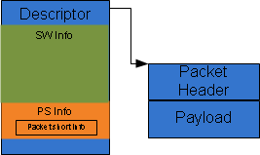
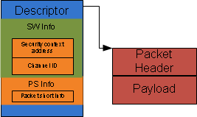
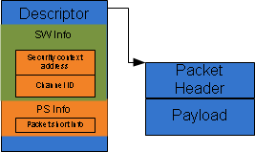
SA LLD: Packet Process (Air Cipher)
Repeat steps 1-6 send more packet.
Step 1: Call SA LLD Sa_chanSendData/ Sa_chanRecieveData
SA
Step 5: SA access the SC for corresponding operation encryption/decryption
Authentication/verification
SA LLD
DSP/ARM
CorePac
Step 2: return security context buffer address
DDR
Step 6: SA forward the result packet to destination
SC for Rx
PKTDMA
Step 3: put the security context buffer address to SW_INFO of descriptor
SC for TX
Step 4: send packet to SA

Slide 22
For More Information
Device-specific Data Manuals for the KeyStone SoCs can be found at TI.com/multicore.
Multicore articles, tools, and software are available at Embedded Processors Wiki for the KeyStone Device Architecture.
View the complete C66x Multicore SOC Online Training for KeyStone Devices, including details on the individual modules.
For questions regarding topics covered in this training, visit the support forums at the
TI E2E Community and Deyisupport website.

